Slide 1


WELCOME TO: Florida’s Expungement Laws: Helping Survivors of Human Trafficking LIVE WEB EVENT!
IF YOU REQUIRE TECHNICAL ASSISTANCE, PLEASE CONTACT US AT:
JITSupport@usf.edu

Slide 2

Your microphones and cameras are disabled for this event. We encourage you to ask questions and share your comments using the Chat and/or Q&A during the event.

Slide 3
You can find the chat icon at the bottom of your screen.
Try it out and send us a chat now.
Let us know where you are from and something you hope to learn today!

Slide 4

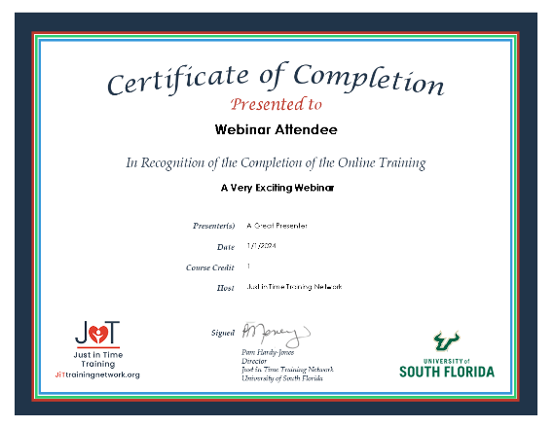



Certificate Information
Certificates will be emailed within two business days.
If you are watching with a group, please email jitsupport@usf.edu to inquire about certificates for your group.
In order to receive a certificate for attending, you must participate in the entire webcast.
If you have any questions about this process, please email jitsupport@usf.edu.
2

Slide 5
About the Just in Time Training Network…
Every child deserves a home filled with safety, love, and unwavering support. Our online foster parent training is designed to empower all caregivers with the skills they need to create an environment where children not only feel safe but thrive.
Contact us to find out how your agency can partner with us to support your caregivers.
https://www.jittrainingnetwork.org/learnmore

Slide 6

Survive and Thrive Advocacy Center (STAC)
Assists ALL trafficking survivors
Care management
Many partners
Outreach esp. to rural areas
Community education
Agency specific training
Notes:
ROBIN

Slide 7
Outreach Materials from STAC
Past webinars and other training programs
Toolkits galore!
For all of these see:
https://www.surviveandthriveadvocacy.org/
All services and support are free of charge
See Event page on STAC website for more!

Slide 8
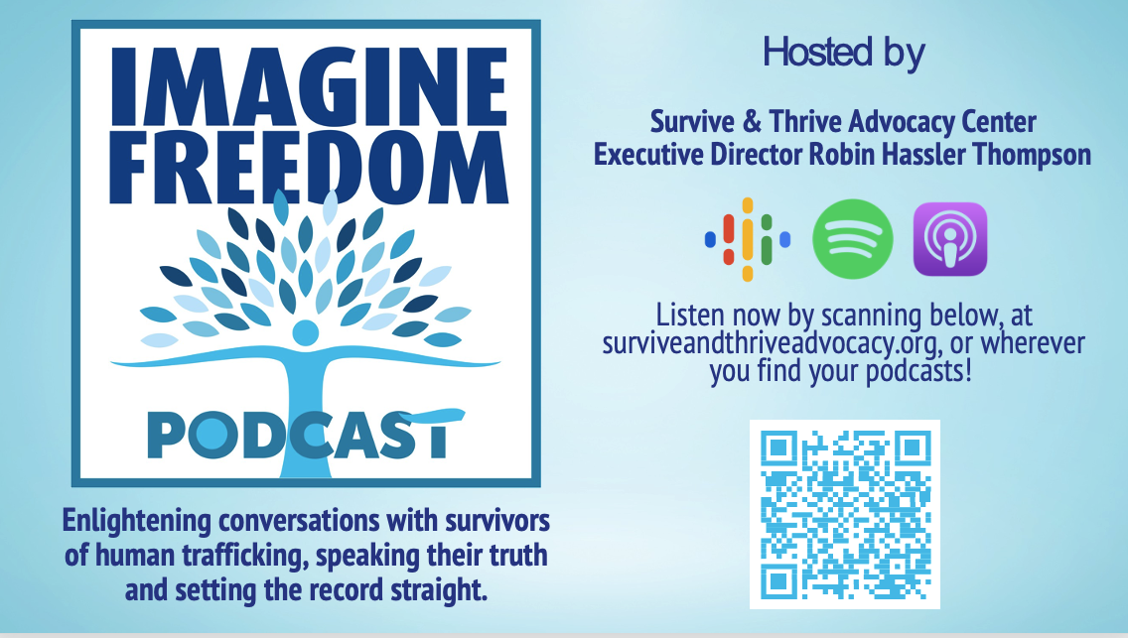

Slide 9

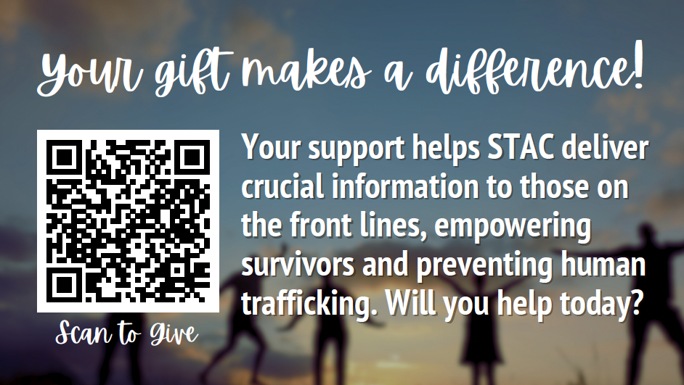

Slide 10



Presenters:
Brent Woody is the lead attorney and executive director of the Justice Restoration Center, a nonprofit organization that provides trauma-informed restorative pro bono legal services and advocacy for survivors of human trafficking, as well as advocates for trafficking-related legislation and policy matters.
Danielle Lennox, Assistant State Attorney, 17th Judicial Circuit, Broward County, FL and currently the head of the Human Trafficking Division and responsible for overseeing the law enforcement investigation of all Broward County human trafficking cases.
Moderator: Robin Hassler Thompson, Executive Director, STAC

