Slide 1
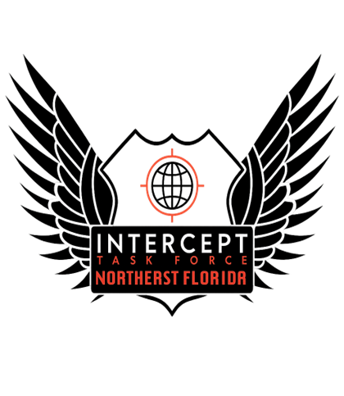
Unmasking Traffickers: Exposing Their Tactics, Disrupting Their Strategies, Empowering Our Solutions
Notes:
Agent Ryan Ellis Slides:
5-12
46-55

Slide 2
Content Overview
Human traffickers
Human trafficking language
Trafficker tactics and psychological control methods
Gang recruitment and human trafficking
Substances used for recruitment
Identifying Commerical sexual Exploited victims and how to report
Notes:
MA Presenter Note:
This slide outlines key foundational concepts related to human trafficking.
Begin by defining human traffickers—emphasize they can be strangers, family members, peers, or authority figures.
Discuss the importance of human trafficking language—using survivor-centered, non-criminalizing terms helps shift stigma and promotes understanding.
Highlight trafficker tactics including grooming, isolation, threats, manipulation, and psychological coercion.
Address how gangs use trafficking as a revenue stream—point out recruitment methods tied to loyalty, survival, or protection.
Discuss how substances like drugs or alcohol are often introduced to create dependency or compliance.
Wrap up with tips on identifying commercially sexually exploited victims (e.g., signs like branding, inconsistent stories, fear of authority) and emphasize how to report, using local hotlines or law enforcement protocols.
Encourage audience to think about how these elements may appear in both obvious and subtle ways across various systems (schools, child welfare, law enforcement, healthcare).

Slide 3
Human traffickers

Slide 4
Mandatory Reporting for all Forms of Sex Trafficking of Minors
Federal law provided the following definitions:
There is a third party who is “brokering” the exchanges of the sexual act for a tangible item, typically money. Pimps can be of any age, any gender, and any background.
Trafficker/Pimp Trafficking
The trafficking is a source of generating money for the gang, and the gang member is involved in the trafficking of the victim.
Gang Trafficking
Familial or Family Controlled Trafficking
This type of sex trafficking occurs when a family member or guardian sells the minor for a sex act.
A type of sex trafficking that does not involve a third party where commercial sex acts are exchanged for basic needs including food, shelter, safety, or to support drug addiction.
Transactional Trafficking
Notes:
Presenter notes:
Reporting sex trafficking to law enforcement and social services is critical to protecting victims, holding traffickers accountable, and preventing further exploitation. Timely reporting ensures survivors receive necessary safety, medical care, and support services, while allowing authorities to investigate, intervene, and dismantle trafficking networks. It is a vital step in breaking the cycle of abuse and promoting justice.

Slide 5

Our Rescue- Trafficking: Myth vs Truth
Notes:
RE Presenter Notes:
The INTERCEPT Task Force is a multi-agency effort focused on early identification and recovery of youth who are victims or at risk of sex trafficking.
NGO's included in the task force: Operation Ligh Shine and Tim Tebow Foundation
Intercept Task Force has also partnered with Underground Railroad "Our Rescue" This video was produced by this NGO and approved to be used for trainings by the Intercept task force and partners.
It brings together law enforcement, child welfare, prosecutors, and NGOs to conduct coordinated, victim-centered operations.
These teams often participate in planned sting operations, missing child recoveries, and online exploitation investigations.
Law Enforcement and NGO Collaboration:
NGOs play a critical role in victim identification and crisis response, especially when survivors are fearful or unwilling to disclose.
They provide trauma-informed advocacy, emergency services, and long-term support to victims.
Law enforcement relies on NGOs for training, survivor engagement, and aftercare planning.
This partnership ensures victims are treated as individuals in need of help—not as criminals—and that traffickers are held accountable.
Key Message: Effective collaboration between law enforcement and NGOs strengthens investigations, enhances victim recovery, and leads to more successful prosecutions with survivor well-being at the center.

Slide 6
Who are human traffickers?
Perpetrators of this crime (traffickers/pimps or buyers/johns)
Do not fit a stereotype
Can come from every social, ethnic, gender, and racial group
May be involved with local or national/international level gangs, larger nationwide and/or international criminal organizational groups, or may have no affiliation with any one specific group
Notes:
Presenter Notes:
It's important to understand that perpetrators of sex trafficking—whether they are traffickers/pimps or buyers/johns—do not fit a single profile or stereotype.
They can come from any background: all races, ethnicities, genders, age groups, and socioeconomic classes. This challenges the misconception that traffickers or buyers are easy to spot.
Some perpetrators are part of organized crime networks, including local gangs, national criminal groups, or even international trafficking rings.
Others may operate alone, with no formal affiliation—making them harder to detect.
This diversity in background and approach underscores the importance of training and awareness across all systems, as anyone could be a trafficker or buyer, regardless of appearance or status.

Slide 7
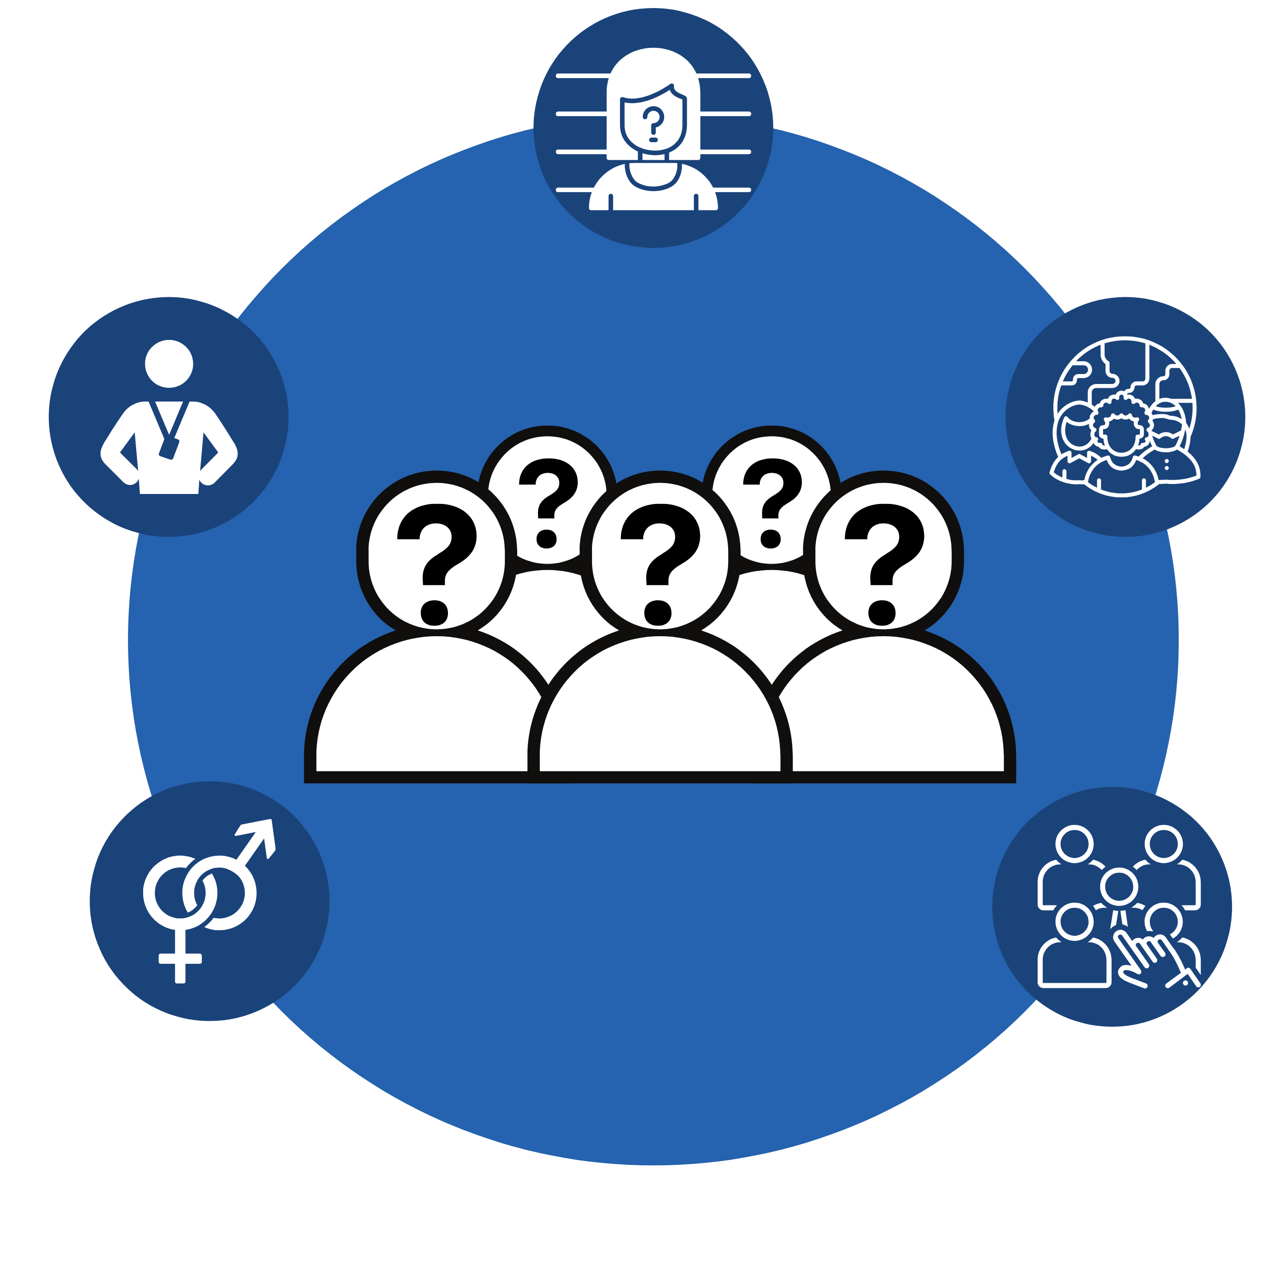
Profiling Human Traffickers
There is no one single profile of traffickers:
A trafficker can be a boyfriend, employer, father, mother, uncle, coach, teacher, or anyone exerting control over someone, even a peer.
Not always organized criminals.
Any ethnicity or race.
Both men and women of varying ages.
Anyone who benefits from the commercial sexual or labor exploitation.
Notes:
Presenter notes:
Key Message:
Perpetrators can look like anyone—there is no “typical” trafficker or buyer. Vigilance and a focus on behaviors, not appearances, are essential for identifying and stopping exploitation.

Slide 8
Who are human traffickers?
Based on human trafficking cases that have been identified by the National Human Trafficking Resource Center, examples of traffickers may include:
Brothel and illegal massage and/or spa business owners and managers
Employers of domestic servants
Gangs and criminal networks
Growers and crew leaders in agriculture
Intimate partners/family members
Labor brokers
Factory owners and corporations
Pimps/sex traffickers
Drug dealers
Small business owners and managers
Notes:
Presenter note:
Traffickers are not always strangers—they may be employers, family members, or individuals operating legitimate-looking businesses. Recognizing the diverse roles traffickers can hold is critical for proper identification and response

Slide 9
Types of Sex Traffickers
Human Traffickers
Romantic Partner/
Traffickers
Business-Oriented
CEO Traffickers
Violent/Brutal Trafficker/
Notes:
Presenter Notes:
Law enforcement agencies categorize traffickers based on patterns of behavior, roles in trafficking operations, and their relationship to the victim. Understanding these types helps inform both prevention and intervention strategies.
Common types of traffickers identified by law enforcement include:
Romeo/Pretender Trafficker:
Gains the victim’s trust by pretending to be a romantic partner or caring friend. Uses manipulation, emotional dependency, and false promises of love or a better life to exploit the victim.
Gorilla/Pimp Trafficker:
Uses force, violence, intimidation, or threats to control and exploit victims. Often operates with a high degree of aggression and control, keeping victims in constant fear.
Familial Trafficker:
A family member—parent, guardian, or relative—who exploits the victim, often for financial gain or substance trade. Common in cases involving youth.
Gang or Group Trafficker:
Involves multiple individuals, often part of a street gang or organized crime group, who collectively traffic victims as a means of income, loyalty, or power.
Business/Corporate Trafficker:
Exploits individuals through legitimate-seeming operations such as labor contracting, factories, agriculture, or massage parlors. Uses fraud, debt bondage, and threats of deportation.
Peer Recruiter or Victim-Turned-Trafficker:
Someone who was once exploited themselves and is now used to recruit others—often seen in trafficking rings involving youth.
Key Message:
Traffickers are not all the same. They use different strategies—emotional, physical, financial, or relational—to control their victims. Identifying the type of trafficker can help determine the most effective response and protective actions for the victim.

Slide 10
Violent Traffickers
Depicted in expensive clothing, jewelry and cars. They produce entertainment videos that shows off the money or enjoy taking pictures with cash and/or expensive items.
Utilize violence, threat of violence, force, fraud and coercion to control the victim.
Are more likely to be involved in gang-affiliated sex trafficking.
Notes:
Presenter Notes:
A violent trafficker, often called a “Gorilla trafficker”, uses force, fear, and physical violence as their primary method of control over victims.
They may beat, rape, threaten, or torture victims to intimidate and break them down psychologically. This type of trafficker relies on fear to maintain obedience and discourage attempts to escape.
Victims often suffer from visible injuries, but many also experience deep trauma that is harder to detect—such as PTSD, anxiety, and learned helplessness.
Violent traffickers may isolate victims, confiscate ID or documents, and constantly monitor or move them to prevent outside contact or disclosure.
This type of trafficker often has a long history of criminal behavior, and victims may be too afraid to testify or even self-identify due to the trauma and threats against them or their families.
Key Message:
Violent traffickers use physical dominance and fear-based tactics to control their victims. These cases require urgent safety planning, trauma-informed interviews, and strong coordination between law enforcement, advocates, and social services to support the victim and build a prosecutable case.

Slide 11
Romantic Partner Traffickers
Most common trafficker/pimp involved in domestic sex trafficking.
Portray themselves as a caring and loving boyfriend or girlfriend to inspire fierce loyalty from the victim.
Spend weeks to months grooming their victims and gaining their trust.
Are master manipulators that seek out their victims' vulnerabilities to capitalize on their need to feel loved, listened, and desired.
Manipulate their victims psychologically so that victims stay or return to trafficker or in the “life” of sex trafficking.
May physically abuse the victim.
Notes:
Presenter Notes:
A Romantic Partner Trafficker, also known as a “Romeo trafficker”, uses emotional manipulation, false affection, and promises of love to lure and control victims.
This trafficker builds a relationship of trust and dependency, often showering the victim with attention, gifts, or promises of a future together.
Once the victim is emotionally attached, the trafficker slowly introduces exploitative demands—encouraging or coercing them to engage in commercial sex or labor “for the relationship,” “to help with money,” or “prove their love.”
Victims may not recognize they are being trafficked, as the abuse is disguised as love or loyalty. They often feel guilt, confusion, or fear of losing the relationship, making them reluctant to leave or seek help.
This type of trafficking is common among youth and young adults, especially those with unmet emotional needs, prior abuse history, or unstable home environments.
Key Message:
Romantic partner traffickers use manipulation instead of physical violence to exploit victims. They prey on emotional vulnerability and create a trauma bond that can be incredibly difficult to break. These cases require compassionate, nonjudgmental engagement to help victims understand the manipulation and begin their recovery.

Slide 12
Business-Oriented/CEO Traffickers
Are more likely to be engaging in “white collar crimes.”
Typically run the operation like a business and may operate additional businesses that are legitimate or illegal.
Most likely linked to massage parlor exploitation and escort services.
May be very successful people in the business or entertainment world.
Notes:
Presenter Notes:
A Business-Oriented Trafficker operates under the guise of a legitimate business or professional enterprise, often making their exploitation harder to detect.
These traffickers may run massage parlors, agricultural operations, restaurants, factories, cleaning services, or construction companies.
They often use fraud, debt bondage, coercion, and document confiscation to exploit workers—especially those who are undocumented, non-English speaking, or economically vulnerable.
Victims may be lured with false job offers, then find themselves trapped in exploitative conditions—working long hours with no pay, living in employer-controlled housing, and under constant surveillance.
In some cases, traffickers will threaten deportation, harm to family, or report victims to authorities to maintain control.
These traffickers are strategic and profit-driven, often operating within complex supply chains or contracting systems that obscure accountability.
Key Message:
Business-oriented traffickers hide behind legal structures and job titles, making labor trafficking appear normal on the surface. Effective identification requires cross-agency coordination, labor inspections, and community awareness, especially in industries known for vulnerable labor forces.

Slide 13
Human trafficking recruitment

Slide 14

Three Common Stages of Recruitment
Traffickers are known to engage in constant recruitment to attempt to entice
individuals into their web of control.
Lure
Trust
Payback
Notes:
Presenter Notes:
Human trafficking recruitment often follows a pattern of Lure, Trust, and Payback. Understanding these phases helps us recognize how victims become trapped.
Lure: Traffickers first attract victims by offering something appealing—this could be a job opportunity, a romantic relationship, a chance for a better life, or even basic needs like food and shelter. This initial bait is designed to exploit the victim’s vulnerabilities, such as poverty, lack of support, or prior trauma.
Trust: Once the victim is engaged, traffickers build a sense of trust and dependency. This may involve emotional manipulation, promises of protection or love, or small favors to create a bond. During this phase, victims may start to believe the trafficker’s promises and feel emotionally attached or indebted.
Payback: After trust is established, traffickers demand “payback”—this is when victims are coerced into providing labor, commercial sex, or other exploitative acts. Payback is often enforced through threats, intimidation, isolation, or even violence. Victims may feel trapped by debt, fear, or emotional bonds, making escape extremely difficult.
Key Message:
The recruitment process is gradual and manipulative, designed to entrap victims psychologically and emotionally before exploitation begins. Recognizing these phases can help responders intervene early and provide support before victims become deeply controlled.

Slide 15
Lure Stage
Pays special attention to them, gives compliments, affection
Offers romance, support, parties, drugs, “glamour” (hair, nails, etc.)
Promises increase of social media followers, popularity in new peer groups and financial gains.
Lure
Trust
Payback
Notes:
Presenter Notes:
Human trafficking recruitment often follows a pattern of Lure, Trust, and Payback. Understanding these phases helps us recognize how victims become trapped.
Lure: Traffickers first attract victims by offering something appealing—this could be a job opportunity, a romantic relationship, a chance for a better life, or even basic needs like food and shelter. This initial bait is designed to exploit the victim’s vulnerabilities, such as poverty, lack of support, or prior trauma.
Trust: Once the victim is engaged, traffickers build a sense of trust and dependency. This may involve emotional manipulation, promises of protection or love, or small favors to create a bond. During this phase, victims may start to believe the trafficker’s promises and feel emotionally attached or indebted.
Payback: After trust is established, traffickers demand “payback”—this is when victims are coerced into providing labor, commercial sex, or other exploitative acts. Payback is often enforced through threats, intimidation, isolation, or even violence. Victims may feel trapped by debt, fear, or emotional bonds, making escape extremely difficult.
Key Message:
The recruitment process is gradual and manipulative, designed to entrap victims psychologically and emotionally before exploitation begins. Recognizing these phases can help responders intervene early and provide support before victims become deeply controlled.

Slide 16
trust Stage
Sells them on the glamour of street life.
Says “I love you” and have sex with the them.
Separates them from his or her family and positive support systems.
Lure
Trust
Payback
Notes:
Presenter Notes:
Human trafficking recruitment often follows a pattern of Lure, Trust, and Payback. Understanding these phases helps us recognize how victims become trapped.
Lure: Traffickers first attract victims by offering something appealing—this could be a job opportunity, a romantic relationship, a chance for a better life, or even basic needs like food and shelter. This initial bait is designed to exploit the victim’s vulnerabilities, such as poverty, lack of support, or prior trauma.
Trust: Once the victim is engaged, traffickers build a sense of trust and dependency. This may involve emotional manipulation, promises of protection or love, or small favors to create a bond. During this phase, victims may start to believe the trafficker’s promises and feel emotionally attached or indebted.
Payback: After trust is established, traffickers demand “payback”—this is when victims are coerced into providing labor, commercial sex, or other exploitative acts. Payback is often enforced through threats, intimidation, isolation, or even violence. Victims may feel trapped by debt, fear, or emotional bonds, making escape extremely difficult.
Key Message:
The recruitment process is gradual and manipulative, designed to entrap victims psychologically and emotionally before exploitation begins. Recognizing these phases can help responders intervene early and provide support before victims become deeply controlled.

Slide 17
Payback/Exploitation Stage
Forces victim to payback by working or providing services.
Sexual exploitation is the abuse of a position of vulnerability, differential power, or trust to profit monetarily or socially from the labor or commercial sex work of another person.
Lure
Trust
Payback
Notes:
Presenter Notes:
Human trafficking recruitment often follows a pattern of Lure, Trust, and Payback. Understanding these phases helps us recognize how victims become trapped.
Lure: Traffickers first attract victims by offering something appealing—this could be a job opportunity, a romantic relationship, a chance for a better life, or even basic needs like food and shelter. This initial bait is designed to exploit the victim’s vulnerabilities, such as poverty, lack of support, or prior trauma.
Trust: Once the victim is engaged, traffickers build a sense of trust and dependency. This may involve emotional manipulation, promises of protection or love, or small favors to create a bond. During this phase, victims may start to believe the trafficker’s promises and feel emotionally attached or indebted.
Payback: After trust is established, traffickers demand “payback”—this is when victims are coerced into providing labor, commercial sex, or other exploitative acts. Payback is often enforced through threats, intimidation, isolation, or even violence. Victims may feel trapped by debt, fear, or emotional bonds, making escape extremely difficult.
Key Message:
The recruitment process is gradual and manipulative, designed to entrap victims psychologically and emotionally before exploitation begins. Recognizing these phases can help responders intervene early and provide support before victims become deeply controlled.

Slide 18
After Recruitment
The trafficker:
The victim:
Breaks down their victim's self-esteem.
Threatens the victim and their loved ones based on information collected on the victim.
Makes the victim feel indebted to their trafficker.
Suggests that the victim owes them financially.
Leads the victim to think that they need their help financially to survive.
Feels obligated to contribute to financially support their trafficker.
Is exposed to emotional, mental, and physical abuse.
Uses intimidation and control.
Feels confined and isolated from family, friends, and positive supports to further bond the victim to their trafficker.
Notes:
Presenter Notes:
After recruitment, victims of human trafficking often enter a phase of intense control and exploitation. Their daily lives become dominated by the trafficker’s demands and restrictions.
Victims may experience physical confinement or forced movement, limited or no access to personal identification or money, and constant surveillance to prevent escape.
They often face threats of violence, actual physical abuse, sexual assault, and psychological intimidation designed to break down their resistance and maintain obedience.
Many victims develop a trauma bond with their trafficker, feeling fear, shame, and confusion, which makes leaving or seeking help even harder.
Victims may also be isolated from friends, family, and support systems, increasing their dependency on the trafficker.
Over time, trafficked individuals can suffer from severe physical and mental health issues, including malnutrition, untreated injuries, depression, anxiety, and post-traumatic stress disorder (PTSD).
Despite these hardships, victims often remain hopeful for rescue or freedom, making early identification and trauma-informed support critical for their recovery.
Key Message:
The post-recruitment period is marked by coercion, control, and trauma. Responders must approach victims with sensitivity, understanding the complex barriers they face in seeking help or escaping exploitation.

Slide 19
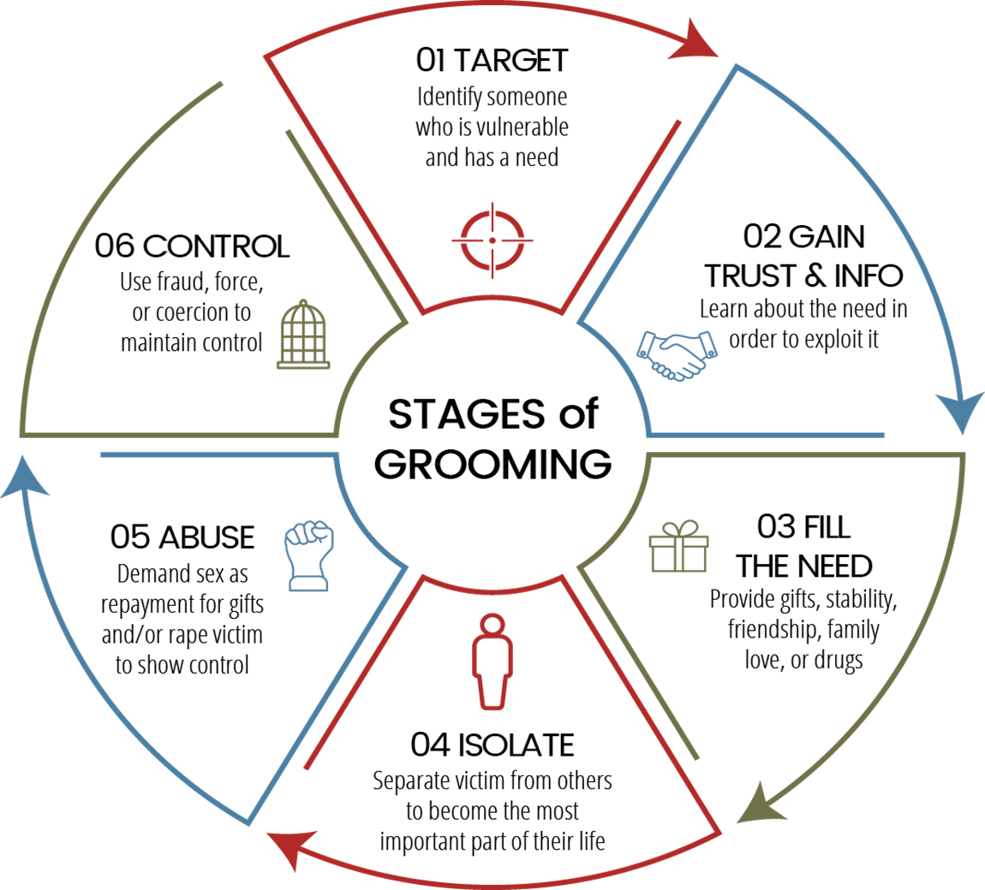
trafficker control
Notes:
Presenter Notes:
The Trafficker’s Wheel of Control illustrates the various tactics traffickers use to dominate and manipulate victims, creating a cycle that traps them in exploitation.
This “wheel” shows how traffickers combine multiple methods to maintain power, rather than relying on just one form of control.
Common spokes on the wheel include:
Isolation: Separating victims from family, friends, or support systems to increase dependency.
Threats and Intimidation: Using fear of violence, deportation, or harm to loved ones to discourage escape or disclosure.
Physical and Sexual Violence: Inflicting harm to break the victim’s will and enforce obedience.
Emotional Manipulation: Creating trauma bonds through false affection, guilt, or shame.
Economic Control: Confiscating money, withholding wages, or imposing debts to maintain financial dependence.
Surveillance and Monitoring: Constantly watching victims to prevent communication or escape.
These tactics work together, reinforcing each other to trap victims in a cycle that’s difficult to break without external intervention.
Understanding the wheel helps responders identify signs of control and tailor victim-centered approaches that address multiple barriers victims face.
Key Message:
Traffickers use a combination of physical, emotional, economic, and psychological controls simultaneously. Breaking the “wheel” requires comprehensive, trauma-informed strategies focused on safety, trust-building, and empowerment.

Slide 20
Understanding Traffickers’ Tactics
Isolation and breaking bonds without a support system.
Creating fear if they leave their trafficker.
Using manipulation to make the victim question their capabilities and mental stability.
Rotating acts of kindness with acts of violence.
Notes:
Presenter Notes:
Traffickers use a variety of tactics to recruit, control, and exploit victims, often adapting their methods based on the victim’s vulnerabilities and environment.
Common tactics include:
Deception and False Promises: Traffickers lure victims with fake job offers, promises of education, love, or a better life. Victims often don’t realize they’ve been trafficked until they are trapped.
Isolation: Victims are separated from family, friends, and any support network to increase dependence on the trafficker. This can be physical isolation or through controlling communication.
Threats and Intimidation: Traffickers use threats of violence, arrest, deportation, or harm to the victim’s family to maintain control and silence.
Physical and Sexual Violence: Many traffickers use beatings, rape, or other forms of abuse to instill fear and enforce obedience.
Confiscation of Documents and Money: Taking passports, IDs, or wages leaves victims vulnerable and unable to leave or seek help.
Psychological Manipulation: Traffickers create trauma bonds by mixing kindness and cruelty, leading victims to feel loyalty or fear toward their trafficker.
Addiction and Substance Abuse: Some traffickers force or encourage drug or alcohol dependency to deepen control.
These tactics often work together, creating a complex system of control that is difficult for victims to break without support.
Understanding these tactics helps responders recognize signs of trafficking and respond in a trauma-informed and victim-centered way.
Key Message:
Traffickers are strategic and manipulative, using a combination of force, fraud, and coercion to maintain control. Awareness of these tactics is critical to identifying and supporting victims effectively.

Slide 21
Isolation and Breaking Bonds
Taking all the victim’s money or not allowing them control over their money while making the victim rely on their trafficker to meet their needs and wants.
Making the victim participate in illegal activities and then using this against them if they try to leave.
Isolating the victim from their family and friends.
Moving the victim to another city or state, so they have no one to call or nowhere to go to ask for help.
Isolation and breaking bonds without a support system.
Notes:
Presenter Notes:
Isolation is a key tactic traffickers use to control victims and prevent them from seeking help or escaping.
This can involve physically separating victims from family, friends, or community—such as keeping them locked in rooms, moving them frequently, or restricting where they can go.
Traffickers also isolate victims by controlling or cutting off communication—limiting phone calls, internet access, or contact with anyone outside the trafficking situation.
Emotional isolation happens when traffickers manipulate victims to distrust others or feel shame and fear, which discourages them from reaching out.
Isolation increases victims’ dependence on the trafficker for basic needs, information, and survival, making it much harder for them to recognize their situation as exploitation.
Recognizing signs of isolation—such as withdrawal, limited social contact, or fearfulness—is crucial for responders to identify trafficking victims and intervene safely.
Key Message:
Isolation is a powerful control method that cuts victims off from support systems, making escape and recovery extremely difficult without external assistance.

Slide 22
Creating Fear
Instills the thoughts that if the victim leaves or even thinks about leaving, they will not receive money or support from their trafficker. They would be left homeless and unable to provide for themselves.
Convinces the victim that they will find them wherever they go if they try to leave.
Threatens to kill the victim or someone they love if they try to leave.
Creating fear if they leave their trafficker.
Notes:
Presenter Notes:
Creating fear is one of the primary ways traffickers maintain control over their victims.
Traffickers use threats of physical violence, harm to the victim or their loved ones, arrest, or deportation to intimidate victims into compliance.
Fear may also be instilled through actual acts of violence or abuse, demonstrating the consequences of disobedience or attempts to escape.
Victims often live in a constant state of fear, which can cause psychological trauma, confusion, and learned helplessness.
Traffickers may threaten to expose victims’ situations to their families or communities, which can carry social stigma or legal consequences.
This climate of fear effectively silences victims, making them less likely to seek help or cooperate with authorities.
Understanding the role of fear helps responders approach victims with patience, build trust, and prioritize safety in interventions.
Key Message:
Fear is a tool traffickers use to dominate victims mentally and emotionally, creating barriers that make escape and disclosure extremely difficult.

Slide 23
Using Manipulation
Using sleep deprivation to control the victim.
Playing tricks with their mind to attempt to convince the victim that they are mentally unstable.
Consistently telling the victim that they are unattractive, that they disgust them, and no one will ever want them because they have done.
Telling the victim that they are only good at sexual acts.
Questioning why the victim is trying to better themselves by furthering their education, detoxing from substances, or getting a job.
Using manipulation to make the victim question their capabilities and mental stability.
Notes:
Presenter Notes:
Manipulation is a psychological tactic traffickers use to control victims by exploiting their emotions and vulnerabilities.
Traffickers may use false promises of love, protection, or a better future to gain the victim’s trust and loyalty.
They often mix kindness with cruelty—showing affection one moment and abuse the next—to create a confusing and dependent relationship, known as a trauma bond.
Victims may feel guilt, shame, or loyalty toward their trafficker, making them reluctant to leave or seek help.
Manipulation can also include gaslighting, where traffickers deny or distort reality to make victims doubt their own perceptions or memories.
By controlling what victims believe or feel, traffickers maintain power without relying solely on physical force.
Understanding manipulation helps responders recognize that victims may not easily identify themselves as being exploited and need compassionate, trauma-informed support.
Key Message:
Manipulation traps victims emotionally and mentally, creating complex barriers to escape that require sensitive and patient intervention.

Slide 24
Addressing the Demand
Strengthening Law by:
Criminalizing the purchase of sex
Law enforcement should target buyers, not the victims.
Increased penalties for buyers
Combating online solicitation
Public Awareness Campaigns:
Educating the public and mandated reporters
Saturate awareness in high-risk areas
Engaging local community leaders
Creating Supports for Survivors:
Establishing emergency safe beds
Increasing behavioral health supports
Creating safe spaces to determine level of treatment needed.
Notes:
Presenter Notes:
Demand for commercial sex and exploitative labor is a key driver of human trafficking. Without buyers or exploiters, traffickers have little incentive to control victims.
Demand can come from individuals seeking commercial sex (“johns” or buyers) or businesses exploiting cheap labor. Reducing demand is critical to disrupting trafficking networks.
Law enforcement approaches to address demand include:
Targeting buyers and exploiters: Conducting sting operations, undercover investigations, and arrests to reduce the market for trafficked victims.
Enforcing laws that criminalize solicitation and labor exploitation: Holding demand-side offenders accountable to deter participation.
Public awareness campaigns: Educating communities about the consequences of buying sex or supporting exploitative labor practices.
Collaborating with community partners and NGOs: To promote prevention efforts and victim-centered responses.
Supporting victim-centered prosecutions: Encouraging survivors to participate in legal processes while ensuring their safety and dignity.
Addressing demand requires a multi-faceted approach that combines enforcement, education, and social change to reduce trafficking incentives.
Law enforcement plays a critical role, but partnerships with social services, policymakers, and the public are essential to create lasting impact.
Key Message:
Reducing demand is essential to ending human trafficking. Law enforcement strategies must focus not only on rescuing victims and prosecuting traffickers but also on disrupting the market that fuels exploitation.

Slide 25
Targeting victims

Slide 26
Understanding Traffickers' Techniques
Coercion and Dependency
Impairment and Compliance
Reward and Punishment
Recruitment Tool and/or Coping
Notes:
Here’s a Presenter Note explaining trafficker techniques used to recruit and continue to exploit victims:
Presenter Notes:
Traffickers use a variety of techniques to recruit victims, often targeting their vulnerabilities such as poverty, lack of support, or previous trauma.
Recruitment techniques include:
False promises of jobs, education, love, or a better life.
Romantic relationships or “grooming” to build trust and emotional dependency.
Recruitment through friends, family, or community members who may be unaware of the trafficking.
Use of social media and online platforms to lure victims with deceptive offers.
Once recruited, traffickers use ongoing exploitation techniques to maintain control:
Isolation from family, friends, and support systems to increase dependence.
Physical and sexual violence to instill fear and compliance.
Threats and intimidation, including threats of deportation, harm to loved ones, or exposure.
Confiscation of documents and money to prevent escape and create financial control.
Psychological manipulation, including creating trauma bonds that make victims feel loyalty or fear.
Inducing substance dependency to deepen control.
Constant monitoring and movement to limit opportunities for escape or outside contact.
These techniques are often layered and adapted over time to reinforce control and exploit victims for profit.
Awareness of these tactics helps responders identify trafficking situations early and provide trauma-informed, victim-centered support.
Key Message:
Traffickers employ a complex mix of deceptive recruitment and ongoing coercion tactics that trap victims physically, emotionally, and economically. Effective intervention requires understanding these methods to disrupt control and support recovery.

Slide 27


Substance Abuse Vulnerabilities
Substance Abuse As A Coping Mechanism: Some victims of human trafficking may abuse substances as a response to the trauma of their trafficking victimization.
Recruitment Through Substance Use: Traffickers may target individuals with existing substance abuse issues to recruit into a trafficking situation.
Control Through Substance Addiction: Traffickers may also use substance addiction to keep victims in a trafficking situation. It can be framed as a reward or punishment, or to decrease the victim’s ability to resist trafficking and abuse.
Notes:
Presenter Notes:
Substance abuse vulnerabilities significantly increase a person’s risk of being targeted for human trafficking or being exploited once trafficked.
Individuals struggling with addiction may face social stigma, isolation, and limited support, making them more susceptible to traffickers’ manipulation.
Traffickers often exploit these vulnerabilities by offering drugs or alcohol to gain trust, create dependency, or maintain control over victims.
Substance use can impair judgment and reduce the ability to recognize danger or seek help, increasing the risk of exploitation.
Victims who are addicted may also face additional barriers to leaving the trafficking situation, such as withdrawal symptoms or the need to maintain a supply.
Understanding the link between substance abuse and trafficking is crucial for responders to provide trauma-informed care and effective interventions.
Support services should address both addiction treatment and trauma recovery to help victims break free from exploitation and begin healing.
Key Message:
Substance abuse creates vulnerabilities that traffickers exploit to recruit and control victims, highlighting the need for integrated, compassionate support that addresses both addiction and trauma.

Slide 28
Coercion and Dependency
Substance use is one of the most influential techniques that human traffickers use to coerce, manipulate, and exploit their victims.
Substances are commonly used to prey on the person's vulnerabilities that leads to the recruitment of labor and sex trafficking.
Traffickers may introduce victims to drugs or alcohol to create a dependency, making victims more reliant on the trafficker for access to the substances they now crave.
Notes:
Presenter Notes:
Traffickers often use substances such as drugs or alcohol as tools to recruit, control, and exploit victims.
In some cases, traffickers offer drugs or alcohol to lure victims—promising a way to cope with stress or pain, or creating a false sense of trust and connection.
Once involved, traffickers may force or coerce victims to use substances, making them physically and psychologically dependent. This dependency increases the victim’s vulnerability and reduces their ability to resist or escape.
Substance use can be used as a form of punishment or control, where traffickers withhold drugs or use intoxication to keep victims compliant and disoriented.
Addiction can also be leveraged by traffickers to exploit victims economically, forcing them to work longer or in more dangerous conditions to support their substance use.
Understanding the role of substances is critical because victims struggling with addiction may face additional stigma and barriers when seeking help.
Responders should approach substance use with compassion, recognizing it as a survival mechanism and a tool of coercion rather than a choice.

Slide 29
Impairment and Compliance
The traffickers may target individuals with existing substance use disorders to recruit into a trafficking situation.
The traffickers may also use substance addiction to keep victims in a trafficking situation.
Victims may be given substances to impair their judgment or physical ability, making them easier to control or less likely to resist.
Notes:
Presenter note:
Substance use is a powerful control mechanism traffickers exploit to trap victims in cycles of addiction, fear, and dependence, complicating escape and recovery.

Slide 30
Reward and Punishment
Substances are sometimes used as rewards for compliance or as a punishment by withholding them, maintaining control over the victim's behavior.
Substances can be used as a reward or punishment, or to decrease the victim’s ability to resist trafficking and abuse.
The trafficker may provide additional substances as a bribe or reward when the victim complies or pleases them. The trafficker may also withhold the substances as a form of punishment if the victim's actions displease the trafficker.
Notes:
Presenter Notes:
Traffickers often use drugs and substances strategically as tools of control through both reward and punishment.
As a reward, traffickers may give victims drugs or alcohol to gain compliance, create temporary relief, or build dependency. Offering substances can be a way to “buy” loyalty or affection, making victims feel momentarily cared for or valued.
Conversely, drugs can also be used as punishment—withholding access to substances as a way to punish or control victims, causing withdrawal symptoms, physical pain, and emotional distress. This increases victims’ desperation to comply to regain access.
Some traffickers force victims to use drugs to decrease their ability to resist or escape, keeping them in a vulnerable and compliant state.
This manipulation through substances creates a cycle of addiction and control that traps victims both physically and psychologically.
Recognizing this dual role of drugs is vital for responders to approach victims with empathy and provide appropriate trauma-informed care and addiction support.

Slide 31
Recruitment Tactics and/or Coping
Substances are commonly used to prey on the person's vulnerabilities that leads to the recruitment of labor and sex trafficking.
In some cases, traffickers exploit individuals who are already struggling with substance abuse, promising access to drugs in exchange for compliance or involvement in trafficking.
Substances can be used to numb victims to the physical and emotional trauma they experience, making them more compliant over time.
Notes:
Presenter Notes:
Many trafficking victims turn to drugs or alcohol as a coping mechanism to manage the intense physical and emotional trauma they experience.
Substance use can provide temporary relief from pain, fear, anxiety, depression, and dissociation caused by abuse, exploitation, and captivity.
Using drugs may help victims numb overwhelming feelings or escape the harsh reality of their situation, even though it often leads to addiction and further harm.
Some victims develop substance dependencies before trafficking, which traffickers exploit; others become addicted during exploitation due to forced or coerced use.
Understanding that substance use is often a survival strategy—not a choice—helps responders approach victims with compassion rather than judgment.
Effective intervention requires trauma-informed care that addresses both the addiction and the underlying trauma to support healing and recovery.
Key Message:
Substance use among trafficking survivors is often a means of coping with trauma, and compassionate, integrated support is essential for their path to healing.

Slide 32
Risk factors

Slide 33
Risk Factors for Recruitment
Young person/vulnerable adult
Substance use
Sometimes feel insecure
Social isolation
Desire to develop romantic relationships
No means to pay for their substance addiction
Intimate partner violence
Co-occurring mental health challenges
Homelessness or unstable housing
Criminal record or legal vulnerability
Test boundaries and take risks
Notes:
Presenter Notes:
Certain risk factors increase vulnerability to human trafficking recruitment, though anyone can be targeted. Understanding these helps in prevention and early intervention.
Common risk factors include:
Poverty and economic hardship: Lack of financial resources makes false promises of jobs or money appealing.
History of abuse or neglect: Past physical, emotional, or sexual abuse can leave individuals vulnerable to manipulation.
Runaway or homeless youth: Lack of stable housing and support increases risk of exploitation.
Unstable family environment: Family conflict, domestic violence, or parental substance abuse may push individuals toward traffickers.
Lack of education or job opportunities: Limited access to education or employment increases susceptibility to deceptive offers.
Social isolation or lack of support network: Feeling alone or disconnected can make traffickers’ attention seem like a lifeline.
Previous involvement in the foster care or juvenile justice systems: These systems can expose youth to higher risks of exploitation.
Immigration status or language barriers: Undocumented or non-English-speaking individuals may fear seeking help due to legal consequences.
Substance abuse or addiction: Addiction can be exploited by traffickers to maintain control.
While these factors increase risk, traffickers often adapt tactics to exploit a wide range of individuals across all demographics.
Early identification of at-risk individuals and providing support can help prevent trafficking and improve outcomes.
Key Message:
Awareness of risk factors helps professionals intervene early and protect vulnerable populations from trafficking recruitment.

Slide 34
Forced Criminal Activity
DRUGS AND LABOR TRAFFICKING
Drug Distribution:
Victims are coerced into transporting or selling drugs as part of trafficking operations.
Traffickers use this as a dual-purpose strategy to profit from drug sales and to entrap victims in criminal activity.
Drug Manufacturing:
Victims may be forced to participate in the production of drugs, often under dangerous and exploitative conditions.
Drug Addiction to Control:
Traffickers intentionally provides drugs to the victims to make them addicted to substances, forcing them to be dependent on the traffickers for their supply and more susceptible to coercion into criminal activities.
Notes:
Presenter Notes:
Forced criminal activity is a lesser-known but significant form of human trafficking, where victims are coerced or manipulated into illegal acts.
Traffickers may compel victims to engage in crimes such as drug trafficking, theft, fraud, or sex work under threat of violence, deportation, or other forms of punishment.
Victims often have little or no choice and may be controlled through fear, violence, or psychological manipulation.
This form of trafficking is used to generate profit for traffickers and further entrap victims by involving them in criminal networks.
Victims forced into criminal activity may be reluctant to seek help due to fear of arrest, stigma, or mistrust of law enforcement.
Understanding this link is vital for law enforcement and service providers to identify victims and differentiate them from willing offenders.
Trauma-informed approaches and victim-centered policies are essential to support survivors of forced criminal activity and provide pathways to safety and recovery.

Slide 35
Forced Criminal Activity
SUBSTANCE ADDICTION AND TRAFFICKING
Sex Trafficking
Victims are forced into selling sex, further isolating them and trapping them in the cycle of exploitation.
Recruitment of Others:
Some victims are coerced into recruiting others, perpetuating the trafficker's operations, and creating further emotional and legal entanglements.
Fraud and Theft:
Victims may be compelled to commit financial crimes like credit card fraud or theft, often under threats of violence or addiction withdrawal.
Notes:
Presenter notes:
Forced criminal activity is a form of human trafficking where victims are exploited through coercion into illegal acts, requiring careful identification and compassionate intervention.

Slide 36
Traffickers Tactics and Consequences
Entrapment: Traffickers deliberately involve victims in criminal activity to ensure their compliance. Victims fear arrest, deportation, or imprisonment if they seek help.
Stigma and Criminal Records: Victims with criminal records face significant barriers to accessing services, employment, or legal protection.
Legal Manipulation: Traffickers leverage the victim’s criminal activity to discredit them, reducing the likelihood of successful prosecution against the trafficker.
Notes:
Presenter Notes:
Traffickers use a variety of tactics to recruit, control, and exploit victims. These include:
Deception: False promises of jobs, education, or relationships to lure victims.
Isolation: Cutting victims off from family, friends, and support systems.
Manipulation: Creating emotional dependence through grooming and trauma bonding.
Threats and Intimidation: Using fear of violence, arrest, or harm to loved ones to maintain control.
Physical and Sexual Violence: Inflicting abuse to enforce compliance and silence victims.
Substance Control: Forcing or encouraging drug/alcohol use to increase dependency.
Confiscation of Documents and Money: Restricting victim’s freedom and access to resources.
These tactics have severe consequences for victims, including:
Physical injuries and chronic health problems.
Psychological trauma such as PTSD, depression, and anxiety.
Addiction due to coerced or self-medicating substance use.
Loss of trust and social isolation.
Economic exploitation and financial instability.
Barriers to seeking help due to fear, shame, or control mechanisms.
Understanding these tactics and consequences is critical for responders to identify victims accurately and provide effective, trauma-informed care.
Key Message:
Traffickers’ tactics are designed to trap victims physically, emotionally, and financially, resulting in profound and lasting harm that requires comprehensive support to address.

Slide 37
Impact of substance abuse

Slide 38
Connecting Trauma and Substance Abuse
Trauma can lead to self-medication: Individuals who have experienced trauma struggle with anxiety, depression, and other mental health issues
Childhood trauma can lead to substance abuse later in life: Studies have shown that individuals who experience childhood trauma, such as abuse or neglect, are more likely to struggle with substance abuse later in life.
Trauma and addiction can co-occur: Trauma and addiction often go hand-in-hand.
Treatment for trauma and substance abuse: Effective treatment for trauma and substance abuse involves a combination of therapies, including cognitive-behavioral therapy (CBT), trauma-focused therapy, and addiction treatment.
Notes:
Presenter Notes:
Trauma and substance abuse are deeply interconnected, especially among victims of human trafficking.
Many survivors use drugs or alcohol as a way to cope with the overwhelming psychological and physical trauma they have experienced.
Trauma from abuse, exploitation, and control can lead to feelings of fear, helplessness, and emotional pain, which victims may attempt to numb through substance use.
Substance abuse often begins as a survival mechanism but can quickly develop into addiction, further complicating recovery.
The cycle of trauma and substance abuse can reinforce itself—substance use may exacerbate mental health issues, while untreated trauma can increase reliance on substances.
Understanding this connection is critical for providing trauma-informed, integrated care that addresses both addiction and the underlying trauma.
Compassionate, non-judgmental approaches improve outcomes and support long-term healing for trafficking survivors.
Key Message:
Effective intervention for trafficking survivors requires addressing both trauma and substance abuse as interconnected challenges to support holistic recovery.

Slide 39
Psychological Impact
The psychological trauma from substance addiction profoundly affects mental and emotional well-being.
It often leads to feelings of guilt, shame, and low self-worth, creating cycles of dependency and despair.
Addiction can damage cognitive function, impair decision-making, and exacerbate mental health issues like depression, anxiety, or PTSD.
Social isolation, strained relationships, and stigmatization further intensify the trauma, making recovery challenging.
The effects can also leave individuals more vulnerable to exploitation and abuse, creating additional layers of psychological harm.
Notes:
Presenter Notes:
Human trafficking causes profound and long-lasting psychological impacts on victims.
Survivors often experience trauma-related disorders such as Post-Traumatic Stress Disorder (PTSD), depression, anxiety, and complex trauma.
Many suffer from feelings of shame, guilt, helplessness, and low self-worth, often internalizing blame for their situation.
The ongoing control, manipulation, and abuse can lead to emotional numbness, dissociation, and difficulty trusting others.
Victims may develop trauma bonds with their traffickers, complicating efforts to escape or seek help.
Psychological effects can also manifest as substance abuse, self-harm, or suicidal ideation.
Understanding these impacts is essential for responders to provide trauma-informed care and support tailored to survivors’ mental health needs.
Recovery often requires long-term counseling, support networks, and safe environments that foster healing.
Key Message:
The psychological impact of trafficking is severe and multifaceted, necessitating compassionate, informed, and sustained intervention to help survivors rebuild their lives.

Slide 40
Physical Impact
Physical trauma from substance addiction can result in severe health consequences, including organ damage, weakened immune function, and increased risk of infectious diseases like HIV and hepatitis from unsafe practices.
Chronic use can lead to cardiovascular issues, respiratory problems, and neurological damage.
Withdrawal symptoms and overdoses cause additional physical strain, sometimes resulting in long-term disabilities or death.
Notes:
Presenter Notes:
Human trafficking often results in significant physical harm and health problems for victims.
Victims may suffer from injuries related to physical abuse, sexual violence, and neglect, including bruises, fractures, burns, and untreated wounds.
Exposure to unsafe or unsanitary conditions can lead to chronic health issues, such as infections, malnutrition, and untreated diseases.
Sex trafficking victims face high risks of sexually transmitted infections (STIs), unwanted pregnancies, and reproductive health complications.
Labor trafficking victims may experience musculoskeletal injuries, exhaustion, and exposure to hazardous environments.
Many victims lack access to adequate medical care, which worsens health outcomes and prolongs suffering.
Physical health problems are often compounded by mental health issues and trauma, requiring integrated care approaches.
Recognizing physical signs of trafficking is critical for early identification and intervention.
Key Message:
The physical impact of trafficking is severe and multifaceted, demanding comprehensive medical and supportive services to address victims’ urgent health needs.

Slide 41
Spiritual Impact
Spiritual trauma from substance addiction involves a deep sense of disconnection from one’s values, purpose, or sense of self.
It can lead to feels of hopelessness, guilt, and shame, creating a belief that redemption or healing is unattainable.
Addiction often isolates individuals from faith communities or spiritual practices, compounding their sense of alienation.
The loss of spiritual grounding can hinder recovery, as individuals may struggle to find meaning or inner strength to rebuild their lives.
Reconnecting with spirituality or sense of purpose can play a crucial role in healing and recovery.
Notes:
Presenter Notes:
Human trafficking often deeply affects a victim’s spiritual well-being, which is an important but sometimes overlooked aspect of recovery.
Victims may experience a loss of faith, hope, or meaning in life due to prolonged abuse, exploitation, and betrayal.
The trauma and control exerted by traffickers can lead to feelings of spiritual disconnection or emptiness, causing victims to question their beliefs or life purpose.
Some survivors struggle with guilt or shame related to their experiences, which can conflict with their spiritual or religious values.
Conversely, for some victims, spirituality or faith can be a source of strength and resilience, offering hope, comfort, and a path toward healing.
Incorporating spiritual care into trauma-informed support—when appropriate and desired by the survivor—can enhance holistic recovery.
Respecting diverse spiritual beliefs and providing access to spiritual counseling or community resources can support survivors’ overall well-being.
Key Message:
Addressing the spiritual impact of trafficking is vital for comprehensive healing, recognizing both the challenges and the potential for faith to aid in recovery.

Slide 42
Emotional Impact
Emotional trauma from substance addiction includes intense feelings of shame, guilt, sadness, and anger, often tied to the addiction’s consequences and strained relationships.
It can lead to emotional numbness or instability, making it difficult to process feelings or build healthy connections.
The cycle of addiction perpetuates these emotions, reinforcing feelings or worthlessness and despair.
This trauma can also impair trust and self-esteem, complicate recovery and leave individuals vulnerable to further harm or exploitation.
Healing requires addressing both the addiction and the underlying emotional wounds.
Notes:
Presenter Notes:
Human trafficking profoundly affects victims’ emotional health, often leading to intense and complex feelings.
Survivors commonly experience emotions such as fear, shame, guilt, anger, sadness, and helplessness.
The trauma of exploitation and ongoing abuse can cause emotional instability, mood swings, and difficulty managing stress.
Victims may struggle with trust issues and attachment difficulties, making relationships challenging.
Many develop low self-esteem and feelings of worthlessness due to the dehumanizing nature of trafficking.
Emotional wounds may also manifest as withdrawal, anxiety, depression, or self-harm.
Understanding these emotional impacts is crucial for responders to offer empathetic, trauma-informed support that fosters safety and empowerment.
Healing often requires time, patience, and access to counseling and peer support networks.
Key Message:
The emotional impact of trafficking is deep and multifaceted, requiring sensitive and sustained interventions to help survivors rebuild their emotional well-being.

Slide 43
Social Impacts
Social trauma from substance addiction stems from damaged relationships, isolation, and stigmatization.
Addiction often leads to broken trust with family, friends, and community, resulting in loneliness and rejection.
The stigma associated with addiction can prevent individuals from seeking help, reinforcing feelings of shame and exclusion.
Social trauma also disrupts support systems, making recovery more challenging and leaving individuals vulnerable to further harm, such as exploitation or homelessness.
Rebuilding connections and fostering acceptance are key to overcoming this aspect of trauma.
Notes:
Human trafficking has significant social consequences that affect survivors’ relationships and community integration.
Victims often experience social isolation due to traffickers’ control tactics or stigma from their communities.
Many survivors face broken or strained family relationships, which can lead to feelings of loneliness and abandonment.
Social stigma and judgment may cause survivors to be shunned or discriminated against, making it difficult to rebuild trust and form new connections.
Trafficking can disrupt education, employment, and social development, limiting opportunities for social and economic stability.
Survivors may also face legal and immigration challenges that complicate reintegration.
Positive social support and community connections are critical for recovery, helping survivors regain a sense of belonging and empowerment.
Programs that promote social inclusion, peer support, and community education help break down stigma and support survivor healing.
Key Message:
The social impact of trafficking isolates survivors and disrupts their lives, highlighting the need for inclusive, supportive community networks to aid in recovery.

Slide 44
Proactive approach
Do not be in denial… you must take action from the first sign of substance use.
When working with a client and the presence of drug use is suspected you must staff your concerns with your supervisor immediately.
Establish a plan of action and clearly document the signs and your concerns.
Complete needed substance evaluations referrals. If the client is involved with DOJ, then notify their probation officer of your concerns.
If you wait, then it may be too late, so do not be afraid to take action…
Notes:
Presenter Notes:
Taking a proactive approach means focusing on prevention, early identification, and coordinated intervention before trafficking escalates.
Education and awareness are key—training communities, schools, law enforcement, and service providers to recognize signs and risk factors.
Building strong partnerships among government agencies, NGOs, law enforcement, healthcare, and community organizations enhances information sharing and resources.
Implementing safe reporting mechanisms encourages victims or witnesses to come forward without fear of retaliation or stigma.
Support programs that address underlying vulnerabilities, such as poverty, homelessness, lack of education, and substance abuse, reduce risk factors.
Promote trauma-informed care to create safe environments that empower survivors and improve recovery outcomes.
Use data and research to inform policies, improve practices, and measure the effectiveness of prevention efforts.
Advocate for laws and policies that strengthen victim protections and hold traffickers accountable.
Key Message:
Proactive approaches combine prevention, education, collaboration, and survivor-centered support to reduce trafficking and help victims more effectively.

Slide 45
How Service Providers Help
Support Substance Abuse Prevention Programs
Provide Access to Treatment
Provide Support and Recovery Services
Engage in Community Collaboration
Implement Harm Reduction Strategies
Connect with Families and Communities
Support Early Intervention
Notes:
Presenter Notes:
Service providers and NGOs play a critical role in the fight against human trafficking by offering essential support and resources to survivors.
They provide safe shelter, medical care, counseling, and legal assistance, helping victims begin the healing process.
NGOs often lead outreach and prevention efforts, educating vulnerable populations about trafficking risks and rights.
Collaboration with law enforcement enhances identification, rescue, and prosecution efforts while ensuring victim-centered approaches.
Many NGOs offer case management and long-term support, including job training, education, and reintegration services.
Service providers build trust with survivors, creating safe spaces where victims feel heard and empowered.
They advocate for policy changes and increased funding to improve systems that protect and support trafficking survivors.
NGOs and providers also contribute to data collection and research to inform effective strategies and improve response efforts.
Key Message:
Service providers and NGOs are vital partners who deliver holistic care, advocate for survivors, and collaborate with stakeholders to combat trafficking effectively.

Slide 46
Gangs and human trafficking

Slide 47
Reasons people join criminal gangs
“SENSE OF BELONGING”
Protection
Money & Drugs
Control of Environment
Racial / Cultural Similarities
Common Enemies
Respect
Acceptance by Peers
Loyalty and Reward
Recruitment
Intimidation
Control of Turf
Notes:
Presenter Notes:
Individuals may join criminal gangs for various complex reasons, often related to social, economic, and psychological factors.
Common reasons include:
Sense of Belonging: Gangs offer a family-like environment and social identity, especially for those feeling isolated or marginalized.
Protection: Joining a gang can provide physical safety in dangerous neighborhoods or situations.
Economic Gain: Gangs offer opportunities for income through illegal activities when legitimate options are limited.
Peer Pressure: Influence from friends or community can push individuals toward gang involvement.
Status and Power: Gangs may offer respect, influence, and a sense of control that individuals crave.
Lack of Positive Opportunities: Limited access to education, employment, or community support can increase vulnerability.
Coercion or Recruitment: Some are forcibly recruited or manipulated into joining.
Understanding these motivations helps in developing prevention and intervention strategies that address root causes.
Key Message:
People join gangs for a mix of protection, belonging, survival, and opportunity, highlighting the need for comprehensive approaches to reduce recruitment and support alternatives.

Slide 48
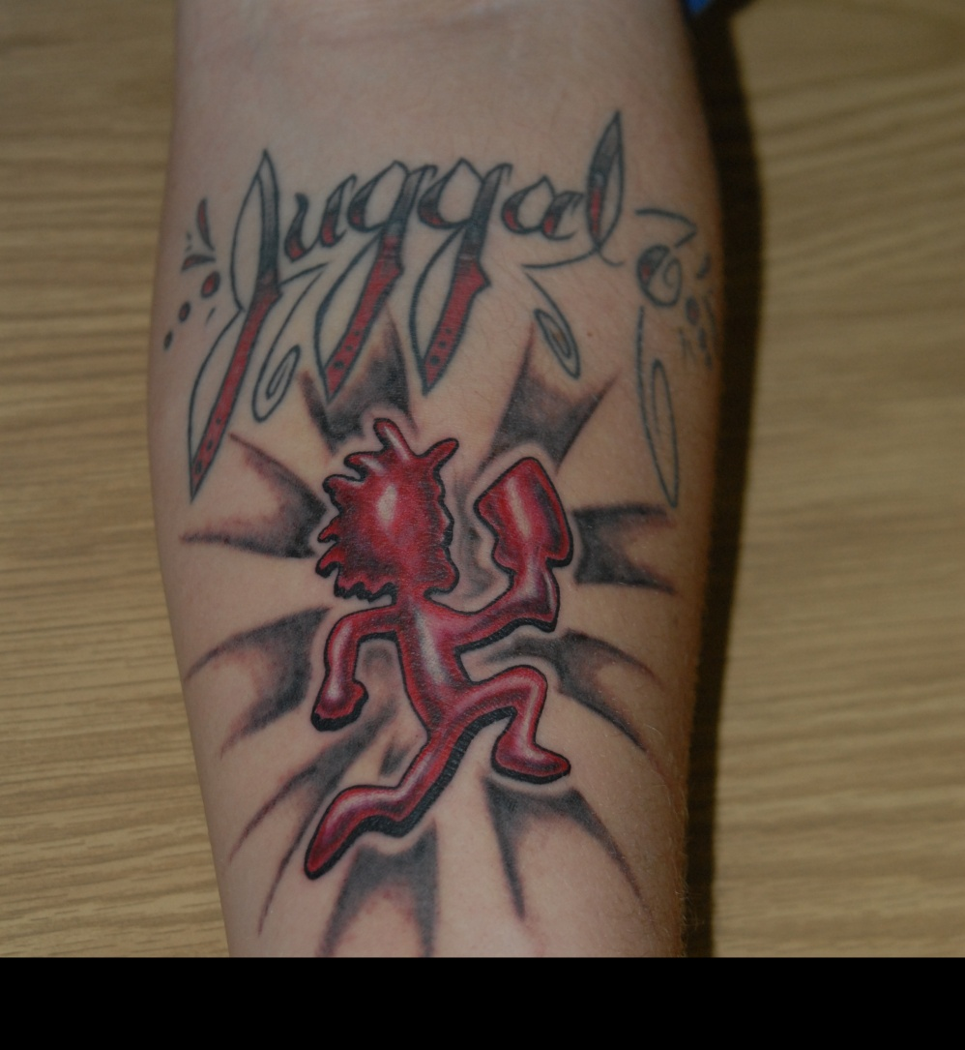



Sex Trafficking Tattoos for women
Notes:
Presenter Notes:
Sex trafficking tattoos are often used by traffickers as a form of branding, ownership, or control over victims.
These tattoos can serve as symbols of possession, marking victims similarly to how property might be marked.
Common designs include initials, names, money signs, barcodes, or symbols that may indicate the trafficker’s identity or gang affiliation.
Tattoos might also represent “earned” status or milestones forced upon victims within the trafficking environment.
Some tattoos are coerced or forced, while others may be done under duress or as a survival mechanism.
Identifying these tattoos can provide important clues for law enforcement and service providers during victim identification.
However, not all trafficking victims have tattoos, and tattoos alone don’t confirm trafficking—context and other indicators are essential.
Awareness of trafficking tattoos helps responders ask sensitive questions and provide appropriate support.
Key Message:
Sex trafficking tattoos are one form of control and branding used by traffickers, offering potential identification clues but requiring careful, trauma-informed consideration.

Slide 49
Gang Initiations
Jumped In: The initiate is beaten by the other gang members for an undetermined amount of time.
Sexed In: A dice is rolled, and the number rolled determines the number of sex partners the initiate must accommodate.
Blessed In: If deemed worthy by the Original Gangsta (O.G.) which is the older members of a gang then they are automatically accepted.
Jumped In: The initiate is beaten by the other gang members for an undetermined amount of time.
Male
Vs.
Female
Notes:
Presenter Notes:
Gang initiation is a process that new recruits undergo to prove their loyalty and commitment to the gang.
Initiations often involve violent or criminal acts, such as assaults, robberies, or even committing serious crimes like theft or assault.
Common initiation rituals include:
“Beat-in” — where the recruit is physically beaten by other gang members for a set amount of time.
“Sex-in” — forced sexual acts, often involving the new member or as a punishment.
Commission of a crime — being required to participate in a criminal activity to earn membership.
These rituals serve to test the recruit’s toughness, obedience, and willingness to break the law.
Initiation creates a psychological bond and loyalty to the gang, often enforced through fear and peer pressure.
For some, initiation marks a point of no return, increasing their vulnerability to exploitation, including trafficking.
Understanding initiation processes can help identify at-risk youth and intervene early.
Key Message:
Gang initiation often involves coercion and violence, reinforcing control and loyalty while increasing the risk of criminal exploitation, including trafficking.

Slide 50
Gang-related factors

Slide 51

Sex Victimization of women in Gangs
The primary role of women in a gang is to provide sexual services to the male gang members, sexual exploitation to profit the gang, and/or drug and gun trafficking for the gang.
Gangs often use social media and websites to advertise and sexually exploit minors and adults.
Gangs often tattoo or brand women in their gang because they view them as their property.
Notes:
Presenter Notes:
Women involved in gangs often face high levels of sex victimization and exploitation within these groups.
Female gang members and associates may be subjected to sexual violence, coercion, and abuse by male gang members.
They can be forced into sex trafficking, prostitution, or sexual servitude as part of gang operations or as “property” of the gang.
Sexual victimization is used as a tool to control, punish, or reward women within the gang hierarchy.
Many women join gangs seeking protection or a sense of belonging but end up trapped in cycles of abuse and exploitation.
Victims often experience trauma, shame, and isolation, which can make it difficult to seek help or escape.
Law enforcement and service providers must understand these dynamics to provide appropriate support and victim-centered interventions.
Addressing sex victimization requires a multi-disciplinary approach including prevention, outreach, trauma-informed care, and legal advocacy.
Key Message:
Sex victimization of women in gangs is pervasive and complex, necessitating informed, compassionate responses to break cycles of abuse and exploitation.

Slide 52
Gang Targets
Disabilities - People with mental health issues face a variety of challenges including isolation, diminished capacity to consent or offer informed consent, and limited ability to assess risk and detect ill-intentions.
Addiction -Traffickers use substance dependency and addiction to recruit and keep control of the trafficked person.
Risk - For gangs, the exploitation of men, women, and children is lucrative and lower risk than other areas such as weapons or drugs.
Notes:
Presenter Notes:
Gangs often target vulnerable individuals who may be more easily influenced or coerced into joining or being exploited.
Common targets include:
At-risk youth — especially those experiencing poverty, family instability, or lack of supervision.
Runaways and homeless youth, who may seek shelter, protection, or a sense of belonging.
Youth with histories of trauma, abuse, or neglect, making them vulnerable to manipulation.
Individuals with low self-esteem or social isolation, who crave acceptance and identity.
Youth in high-crime or underserved neighborhoods with limited access to education and employment.
Sometimes adults who may be coerced into gang activities or trafficking roles.
Gangs exploit these vulnerabilities by offering perceived protection, economic opportunity, and social status.
Understanding who gangs target helps inform prevention efforts focused on building protective factors and support networks.
Key Message:
Gangs strategically recruit vulnerable individuals by exploiting their needs for safety, belonging, and opportunity, underscoring the importance of early intervention and support.

Slide 53
Links Between Gangs, Substances, and Trafficking
Feeding Addiction to Generate Revenue: Profits from drug sales and trafficking are reinvested to sustain and expand gang operations, perpetuating cycles of exploitation.
Coping Vulnerability: Victims of trafficking often turn to substances as a coping mechanism, further entrenching their dependency and making escape even more difficult.
Gang Control: Gangs thrive in areas with poverty, lack of resources, and high rates of addiction, creating environments where trafficking and substance abuse thrive.
Stigma and Perception: Victims of trafficking and addiction are often stigmatized, leaving them with limited access to support, making them even more vulnerable to continued exploitation.
Systematic Change: This complex relationship highlights the need for integrated approaches to combat gang activity, trafficking, and substance abuse simultaneously, addressing root causes and providing support for victims to break free from these cycles.
Notes:
Presenter Notes:
Gangs often have interconnected involvement in substance abuse, drug trafficking, and human trafficking.
Substance distribution can be a major source of income and control for gangs, who may also exploit trafficking victims to support these operations.
Victims of trafficking are sometimes forced or coerced into substance use to maintain control and dependency, linking drug abuse with exploitation.
Gangs may recruit individuals by offering drugs or by preying on those already struggling with substance abuse vulnerabilities.
The profits from drug sales and trafficking frequently fund gang activities, including trafficking operations.
Substance abuse can also be a tool used by traffickers to manipulate victims, impair judgment, and reduce resistance.
Law enforcement and service providers must address the overlapping nature of gang activity, drug abuse, and trafficking for effective intervention.
Prevention and recovery efforts should integrate substance abuse treatment with anti-trafficking services to address these linked issues comprehensively.
Key Message:
The connection between gangs, substances, and trafficking creates a complex cycle of exploitation and control that requires coordinated, multi-disciplinary responses.

Slide 54
How You Can Prevent Gang Involvement
Do not be in denial… you must take action from the first sign of gang affiliation.
When the first sign of gang involvement are present then staff with your supervisor.
Establish a plan of action and clearly document the signs and your concerns.
Notify your local law enforcement gang unit.
Notes:
Presenter Notes:
Preventing gang involvement requires a multi-faceted approach focused on addressing root causes and providing positive alternatives.
Key prevention strategies include:
Building strong, supportive relationships with family, mentors, and community members to provide a sense of belonging.
Promoting positive youth development through education, extracurricular activities, and skill-building opportunities.
Increasing awareness of gang recruitment tactics so youth can recognize and resist pressure.
Providing safe spaces where at-risk individuals can find support, guidance, and resources.
Addressing underlying issues such as poverty, trauma, substance abuse, and lack of opportunity that increase vulnerability.
Collaborating with schools, law enforcement, and community organizations to create early intervention programs.
Encouraging community involvement and neighborhood improvement initiatives to reduce crime and increase safety.
Empowering youth to make healthy choices and envision positive futures is crucial in steering them away from gangs.
Key Message:
Prevention is about strengthening protective factors and providing positive, supportive environments to reduce the appeal and need for gang involvement.

Slide 55
Identifying commercial sex exploitation (CSE) victims

Slide 56

Identifying Sex Trafficking Victims
Is the individual showing signs of trauma?
Does the individual have control of their earnings or lack knowledge about their finances?
Do they have items that they can not afford? Do they have a substance addiction with no obvious means to support?
Are they being isolated from family, friends or other positive support systems?
Notes:
Presenter Notes:
Identifying sex trafficking victims requires careful observation of behavioral, physical, and situational indicators.
Common signs include:
Victims may appear fearful, anxious, or submissive, often avoiding eye contact or communication.
Signs of physical abuse or neglect, such as bruises, malnourishment, or poor hygiene.
Lack of control over their identification documents or finances.
Being accompanied by a controlling person who speaks for them or restricts their movements.
Frequent movement between locations or living in suspicious places like brothels, hotels, or illicit massage parlors.
Inconsistent or scripted responses when questioned.
Evidence of branding or tattoos indicating ownership.
Victims may also show signs of substance abuse, untreated health issues, or trauma-related symptoms.
It is important to approach suspected victims with sensitivity and confidentiality to build trust.
Reporting mechanisms should be clear, ensuring victims receive immediate protection and access to services.
Key Message:
Recognizing the complex signs of sex trafficking is vital for timely intervention and connecting victims with life-saving support.

Slide 57
Identifying Sex Trafficking Victims
Are they affiliated with a gang?
What type of social media, apps or webpages do they use? Do they have their pictures on advertising or sex work pages?
Do they frequently visit or stay in hotels/motels? Do they work in an exotic dance club? Do they live where they work?
Notes:
Key Message:
Recognizing the complex signs of sex trafficking is vital for timely intervention and connecting victims with life-saving support.

Slide 58
Physical and Behavioral Signs
Visible signs of abuse, such as unexplained bruises, blackeyes, cuts, or marks
Exhibiting behaviors, like fear, anxiety, depression, submission, tension, and/or nervousness
“Hyper-vigilance” or paranoid behavior
Having interest in, or in relationships with, adults or older men
Notes:
Presenter Notes:
Physical Signs:
Unexplained injuries such as bruises, cuts, burns, or scars from physical abuse or restraints.
Signs of malnutrition, dehydration, or poor hygiene.
Evidence of untreated sexually transmitted infections or other health problems.
Tattoos or brands that may indicate ownership or control by traffickers.
Signs of substance abuse or withdrawal symptoms.
Wearing inappropriate or unusual clothing for the setting or weather, sometimes controlled by traffickers.
Behavioral Signs:
Appearing fearful, anxious, depressed, or withdrawn.
Avoiding eye contact or communication, often deferring to someone else who seems controlling.
Exhibiting submissive or nervous behavior, including flinching or startling easily.
Inconsistent stories or scripted responses when questioned.
Reluctance or inability to explain their whereabouts or circumstances.
Signs of trauma such as hypervigilance, dissociation, or emotional numbness.
Frequent absences from school, work, or home without clear explanation.
Social isolation or limited interaction with others.
Key Message:
Awareness of these physical and behavioral signs helps responders identify victims and provide appropriate support and intervention.

Slide 59
Controlling Relationships
Evidence of controlling or dominating relationships
  Repeated phone calls from a “boyfriend.”
  Overly concerned about displeasing or upsetting their partner.
Unexplained shopping trips or possession of expensive clothing, jewelry, or a cell phone could indicate the manipulation of an exploiter.
Not in control of their own money.
Use of lingo or slang from “the life” among peers or referring to a boyfriend as “Daddy.”
Notes:
Presenter Notes:
Controlling relationships and dating violence share many dynamics with trafficking, including power, control, and manipulation.
Traffickers often establish romantic or intimate partner roles to gain trust and control victims—this is sometimes called the “lover-boy” tactic.
Victims may initially believe they are in a loving relationship but gradually experience isolation, coercion, and abuse.
Dating violence can escalate into trafficking when the abusive partner forces or coerces sexual exploitation or labor.
Both trafficking and dating violence victims experience fear, emotional manipulation, and threats, making it hard to leave the relationship.
Recognizing signs of controlling behavior and dating violence is critical to identifying trafficking victims early.
Prevention and intervention strategies should address healthy relationship education, empowerment, and access to support services.
Service providers and law enforcement must be trained to understand these links to provide trauma-informed care and effective interventions.
Key Message:
Controlling relationships and dating violence can be gateways to trafficking; understanding these connections enhances victim identification and support.

Slide 60
Personal Information
Secrecy about whereabouts.
Unaccounted for time, vagueness concerning whereabouts, and/or defensiveness in response to questions or concern.
Staying out late or keeping unusual hours.
Has an explicitly sexual social media profile via the internet and/or smart phone apps, etc.
A tattoo that he or she is reluctant to explain may be the result of tattooing or branding by a trafficker.
Lying about personal information, such as age, name, and/or date of birth.
Has no identification or is not in control of his or her identification documents.
Notes:
Presenter Notes:
Traffickers often gather and exploit victims’ personal information as a means of control and manipulation.
This information can include family details, financial data, immigration status, past trauma, or secrets the victim may want to keep private.
Traffickers use threats to expose, harm, or shame victims or their loved ones if they try to escape or seek help.
They may also leverage fear of legal consequences, especially if victims are undocumented or involved in illegal activities.
Using personal information creates a powerful psychological barrier to disclosure and escape, increasing the victim’s isolation and dependency.
Awareness of this tactic helps responders approach victims with sensitivity, confidentiality, and assurance of safety.
Protecting victims’ information and offering secure, supportive environments is essential for effective intervention.
Key Message:
The exploitation of personal information is a critical tactic traffickers use to maintain control, making trust-building and confidentiality vital in helping victims.

Slide 61
Investigative Case Study

Slide 62
CSEC Investigation
Tip Received from the FLA-Safe Hotline and the Florida Child Abuse Hotline
Child Victim: Jenna - 14-years-old
Alleged Perpetrator: Jared - 21-year-old male
Allegations: There are concerns that Jenna is using drugs. She has an adult boyfriend and there are concerns that the boyfriend is her trafficker. Jenna has been seen with expensive items and cash. It is believed that Jenna is involved in sex trafficking and online exploitation.
Notes:
Presenter notes:
Read the allegation that was received from the FLA-Safe Hotline and the Florida Child Abuse Hotline

Slide 63
Preliminary Findings
Jenna: 14-years-old –high school freshman.
Lives with her mother and infant sister.
Attends Riverview Academy, a small Charter school in Orlando, FL
Has recently become withdrawn at home and observed to be hanging out with a group of juniors and seniors.
The mother has reported changes in her behavior, mood, friends, and clothing.
The mother has filed over 10 missing person reports with the police. The missing episodes range from 2 days to 12 days at a time. She has refused to disclose who is paying for the rooms.
Notes:
Presenter notes:
Discussed the preliminary findings. Elaborate on the collaborations between DCF and LE.

Slide 64
Preliminary Findings
Law enforcement has recovered Jenna at various hotels. The hotels were rented under multiple people’s names. Jenna told the police her friends paid for the rooms but refuses to provide her friends names.
The mother reported that Jenna is returning home with her nails done, her hair dyed, and recently observed a tattoo on her neck, behind her ear. The tattoo is the initials “JJ” in small cursive letters.
Jenna admitted she has been dating Jared for several month and they met at school.
Jenna told her mother that Jared has put her initials on his neck, and they got the tattoos together to prove their loyalty to one another.
The mother also stated that Jenna latest tattoos are of a tiara on her lower back with “his princess 4 life” surrounding the tiara.
Notes:
Presenter Notes:
Collaboration between social services and law enforcement is crucial for effectively addressing sex trafficking and supporting victims.
Law enforcement focuses on investigation, rescue, and prosecution, while social services provide trauma-informed care, safety planning, and long-term support.
Working together ensures a holistic approach that addresses both the legal and human needs of victims.
Social services help build trust with victims, encouraging them to cooperate with law enforcement while ensuring their emotional and physical well-being.
Coordination improves information sharing, making investigations more effective and increasing the chances of successful prosecutions.
Joint efforts reduce the risk of secondary trauma or victim re-traumatization during the investigative process.
Multi-disciplinary collaboration also aids in identifying at-risk individuals early and preventing further exploitation.
Ultimately, partnership maximizes resources, enhances victim safety, and strengthens community responses to trafficking.
Key Message:
Effective anti-trafficking work depends on strong collaboration between social services and law enforcement to balance justice with compassionate care.

Slide 65
Collateral/Witness Statements
Law Enforcement and Social Services interviewed Jenna’s therapist, Linda Smith, LCSW. The therapist reported that Jenna has stated that she felt trapped at home and has admitted to leaving school 2-3 times a week without permission and skipping several classes. Jenna has refused to provide names of the people she is with during her missing episodes. The therapist reported that Jenna’s phone has “blown up” with calls and texts during her sessions and Jenna appears fearful if she does not quickly respond to the calls or texts.
Law Enforcement and Social Services interviewed Jenna’s teacher, Jane Johnson. Mrs. Johnson advised she has been seen Jenna leaving campus on a few occasions with two older students – one male (Jared Jones age 21) and one female (Sarah - age 19) both known around school for their disruptive behavior.
  Jenna never appeared to enjoy her time with the two students, but she also never complained about them to anyone and appeared to go willingly.
  Jenna has multiple phones that have WIFI and data capabilities.
  Jenna’s teacher has observed Jenna and Jared having verbal disputes leading to a physical altercation in the school parking lot. She confronted Jenna and she denied the altercation.
  She reported the male was always playful with her, and the observation was
  misinterpreted. Jenna has been coming to school after her missing episodes with her
  nails painted, her hair dyed, and new tattoos.
Notes:
Presenter Notes:
Gathering evidence from family members and collateral contacts is essential in sex trafficking cases to provide a complete and accurate picture of the victim’s situation.
Families and collaterals can offer critical background information, history, and context that may not be immediately evident from the victim alone.
Their insights can help identify patterns of abuse, coercion, or trafficking networks, strengthening investigations and case planning.
Engaging family and collateral sources can support victim safety planning and recovery by building a trusted support system.
Evidence from these sources can corroborate the victim’s statements, increasing the credibility and strength of legal cases.
However, it’s important to approach families and collaterals carefully, ensuring they are trustworthy and do not pose additional risks to the victim.
Maintaining confidentiality and sensitivity throughout this process protects all parties and supports trauma-informed practices.
Key Message:
Evidence gathered from family and collateral contacts enhances investigations, supports victim recovery, and contributes to successful case outcomes.

Slide 66
Investigative Findings
Jared Jones is a 21-year-old male and former student at Jenna’s school. He is known to be gang affiliated and violent.
Jared demanded Jenna “keep him a secret” and she talked he was going to hurt her and her family including her infant sister.
Jared controlled Jenna, by providing her a cell phone, to always know her location and she knew when he would text, “let’s go” she needed to comply.
Jenna views Jared as her boyfriend and she is very fearful but protective of
Jared has past convictions of drug possession with intent to sell and has a documented substance addiction.
Jared also has a documented opioid addiction; he began trafficking Jenna to support his drug addiction.
Notes:
Presenter notes:
Discuss the findings of this investigation. Focus on the facts that effective anti-trafficking work depends on strong collaboration between social services and law enforcement to balance justice with compassionate care.

Slide 67
Investigative Findings
Jared would often make the other female, Sarah Smith recruit other females. Jared would give the females drugs and alcohol then record them engaging in sexual acts. If the females did not comply, he threatened to hurt their families and post the sexual content on their social media pages. He used force and coercion to make the females engage in sexual acts with older males at various motels.
Jared told Jenna he wanted to be a photographer, and he convinced her to let him take pictures of her to submit for local modeling contest. Instead, he posted the images online and advertised the youth for sex
Jenna and the other female were made to provide all the cash to Jared. Jared would take the females to get their nails and hair done but, withheld the money so they could not buy just anything they wanted. They must have Jared permission to buy items for themselves likes snacks or personal items.
Jenna is on multiple dating apps such as Tinder and Facebook dating. She also has multiple handle names on Instagram and Snapchat. She meeting people in person that she met on the dating and the apps.
Notes:
Presenter notes:
Discussed the findings. Elaborate on the collaborations between DCF and LE.

Slide 68
Investigative Techniques
Victim Interviews & Trauma-Informed Interviewing (ongoing due to building trust is the priority)
Parent Statements
Colleterial Statements
Technology Searches and request
Undercover Operations
Financial Analysis
Multi-Agency Collaboration
Partnering with:
Child Protective Services (CPS)
Homeland Security Investigations (HSI)
Federal Bureau of Investigations (FBI)
Local Human Trafficking Task Force
Florida Department of Law Enforcement Investigations and
Missing Endangered Persons Information Clearinghouse (MEPIC)
Internet Crimes Against Children (ICAC) Task Forces
National Center for Missing and Exploited Children
Notes:
Presenter Notes:
Investigating human trafficking requires a range of specialized techniques to gather evidence and build strong cases.
Common investigative methods include:
Undercover operations to infiltrate trafficking networks or brothels.
Surveillance and monitoring of suspects, locations, and communication patterns.
Interviewing victims and witnesses using trauma-informed approaches to elicit accurate, detailed information.
Digital forensics, including analysis of phones, computers, social media, and online ads to uncover recruitment, control, and exploitation activities.
Financial investigations to trace money flows, transactions, and profits connected to trafficking.
Collaboration with other agencies and NGOs to gather intelligence and share resources.
Use of victim testimony supported by corroborating evidence to strengthen prosecution.
Utilization of forensic evidence such as DNA, fingerprints, and physical evidence from crime scenes.
Investigators must balance the need for thorough evidence collection with sensitivity to the victim’s safety and trauma.
Building a successful case often requires a multi-disciplinary, multi-agency approach to cover all aspects of trafficking.
Key Message:
Effective trafficking investigations rely on diverse, coordinated techniques that combine intelligence gathering, victim support, and forensic evidence.

Slide 69
Investigative Techniques​
Multi-Agency Collaboration
Child Protective Services (CPS)
Homeland Security Investigations (HSI)
Federal Bureau of Investigations (FBI)
Local Human Trafficking Task Force
Florida Department of Law Enforcement Investigations and
Missing Endangered Persons Information Clearinghouse (MEPIC)
Internet Crimes Against Children (ICAC) Task Forces
National Center for Missing and Exploited Children
Investigative Techniques
Victim Interviews & Trauma-Informed Interviewing (continually building trust is priority)
Parent Statements
Colleterial/Witness Statements
Cell phone and digital forensics
Search Warrants
Physical and Electronic Surveillance
Undercover Operations
Financial Analysis
Notes:
Presenter notes:
Effective trafficking investigations rely on diverse, coordinated techniques that combine intelligence gathering, victim support, and forensic evidence.

Slide 70


Floridian Freedom Times
www.FloridianFreedomTimes.com
May 11, 2025
State of Florida: He Promised Her Forever — Instead, He Sold Her Dreams for Profit
Jared Jones, a 21-year-old male, and known gang member from Orlando, Fl was arrested this week on charges of human trafficking. Jones met the victim at a local high school. The two began dating and he promised to love her forever and marry her. Jones told her he wanted to be a photographer, and he convinced her to let him take pictures of her to submit for local modeling contests. As time went on, Jones encouraged more sexually graphic images. The young victim complied because she did not want to make Jones unhappy. Jones posted the images online and advertised the youth for sex. When the youth discovered the ads, she tried to break up with Jones. However, Jones threatened
to post the images to her social media pages and send the photos and videos to her friends at school. Jones threatened the youth, if she ever told anyone about him, he would harm her family. Jones had been trafficking the youth for nearly a year before the police received a tip from the Florida Human Trafficking Hotline. Jones has been charged with human trafficking, drug trafficking and possession, production and distributing Child Sexual Material.
If you suspect human trafficking, please contact the Florida Abuse Hotline 1-800-96-ABUSE or the Florida Human Trafficking Hotline 1-855-FLA-SAFE
Notes:
Presenter notes: Read the Headlines. Many cases may result in media releases.

Slide 71
Community Human Trafficking Identification Guide for Commercial Sexual Exploitation of Children (CSEC) and Labor Trafficking

Slide 72
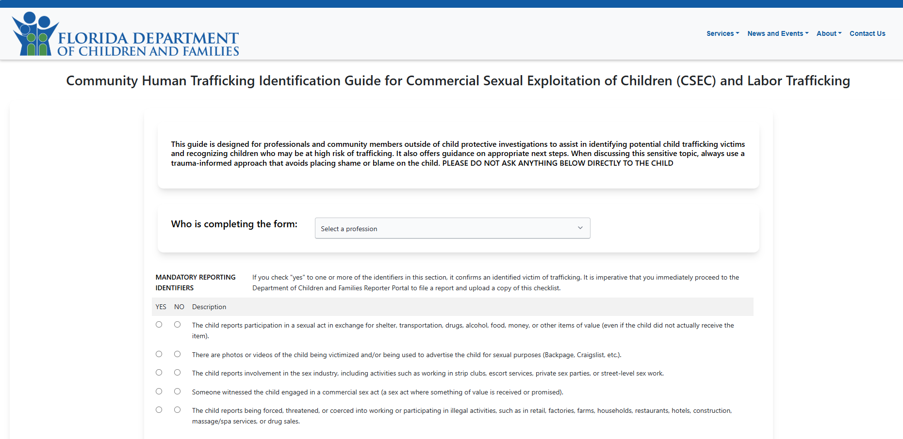
Notes:
Presenter notes:
The Florida Department of Children and Families (DCF) has developed the Community Human Trafficking Identification Guide as part of its comprehensive strategy to combat human trafficking. This tool is designed to assist professionals—such as teachers, healthcare providers, and community leaders—in recognizing and reporting potential cases of child exploitation and trafficking. Developed in collaboration with the University of South Florida, the guide incorporates evidence-based practices to enhance early detection and intervention efforts. (myflfamilies.com, floridapolitics.com)
Key Features of the Community Human Trafficking Identification Guide:
Target Audience: Professionals who interact with children and adolescents, including educators, medical personnel, and community service providers.
Purpose: To equip community members with the knowledge to identify signs of trafficking and take appropriate action.
Content: The guide outlines common indicators of trafficking, such as:
Frequent absences from school or unexplained tardiness.
Sudden changes in behavior or appearance.
Signs of physical abuse or neglect.
Involvement in commercial sex acts or solicitation.(prod.myflfamilies.com)
Implementation: Professionals are encouraged to use the guide as a reference during interactions with youth, particularly when there are concerns about potential trafficking.
Reporting Mechanism: If indicators of trafficking are observed, the guide advises professionals to report their concerns to the Florida Abuse Hotline at 1-800-962-2873 or to local law enforcement.(myflfamilies.com)
By utilizing this guide, community members play a crucial role in the early identification and intervention of human trafficking cases, ensuring that at-risk youth receive the protection and support they need.

Slide 73
See it, suspect it, report it!
Florida Human Trafficking Hotline
1-855-FLA-Safe
DCF Abuse Hotline (minors and vulnerable adults)
1-800-96-ABUSE
National Human Trafficking Hotline (resources for minors and vulnerable adults)
1-888-373-7888
The Senior Protection Team will also attempt to identify emerging scams, spot trends and stay ahead of changes in technology used to prey on seniors.
To report please call (866) 9NO-SCAM or file a complaint at
Florida Attorney General - Citizen Services Contact Form (myfloridalegal.com)
Notes:
Presenter Notes:
Reporting human trafficking crimes is essential to protecting victims and disrupting traffickers’ operations.
Timely reports allow law enforcement to investigate, rescue victims, and bring perpetrators to justice.
Many victims are unable or afraid to seek help themselves due to fear, manipulation, or threats. Reporting by witnesses or professionals can be a lifeline for them.
Early reporting helps prevent further exploitation and can save lives by interrupting trafficking cycles.
It ensures victims gain access to critical services, including medical care, counseling, and legal support.
Reporting also contributes to data collection and awareness, helping agencies identify trafficking trends and allocate resources effectively.
Failure to report may allow traffickers to continue harming vulnerable individuals and perpetuate systemic abuse.
Encouraging a culture of reporting empowers communities to take a stand against trafficking and supports coordinated response efforts.
Key Message:
Every report matters—it is a vital step toward ending human trafficking and protecting survivors.

Slide 74

Questions?
Marina Anderson
Department of Children and Families Statewide Human Trafficking Training Specialist Marina.Anderson@myflfamilies.com
Detective R. Ellis ID#6773
Homeland Security Investigations INTERCEPT Taskforce
Human Exploitation / VICE /North FL ICAC
rmellis@claysheriff.com
Florida Department of Children and Families
Notes:
Trainer Notes:
Email is the best way to contact

