Slide 2
Definitions
Restitution
Forfeiture
Restoration
Remission
Civil Damages through Litigation for Trafficking Survivors

Slide 3
Mandatory Restitution
When the Federal Government brings a trafficking prosecution under the Trafficking Victims Protection Reauthorization Act,
Criminal Restitution is mandatory under
18 U.S.C. §1593

Slide 4
MANDATORY RESTITUTION
Definition of “full amount of the victim’s losses” under TVPRA, 18 U.S.C. §1593
…the term “full amount of the victim’s losses” … shall in addition include the greater of the gross income or value to the defendant of the victim’s services or labor or the value of the victim’s labor as guaranteed under the minimum wage and overtime guarantees of the Fair Labor Standards Act.

Slide 5
Definition of “full amount of the victim’s losses” under
TVPRA, 18 U.S.C. §1593:
Definition.— For purposes of this subsection, the term “full amount of the victim’s losses” includes any costs incurred by the victim for—
(A) medical services relating to physical, psychiatric, or psychological care;
(B) physical and occupational therapy or rehabilitation;
(C) necessary transportation, temporary housing, and child care expenses;
(D) lost income;
(E) attorneys’ fees, as well as other costs incurred; and
(F) any other losses suffered by the victim as a proximate result of the offense.

Slide 6
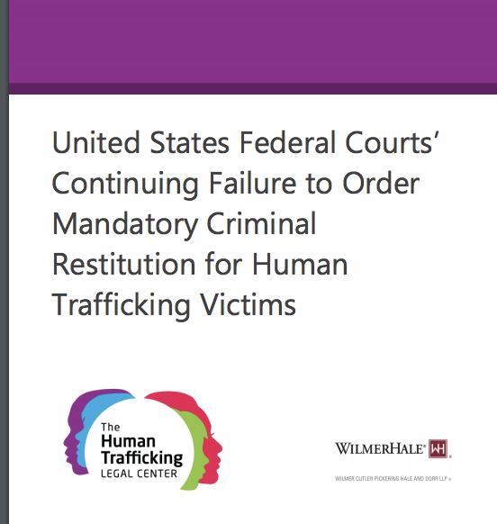

Slide 8
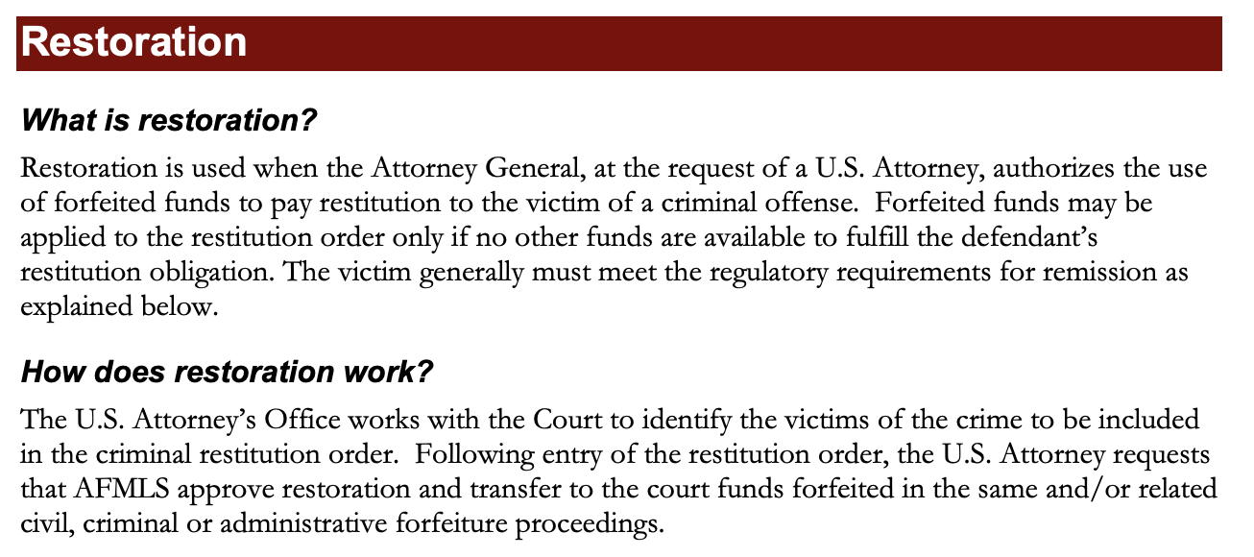
https://www.justice.gov/sites/default/files/criminal-afmls/legacy/2015/01/26/victms-faqs.pdf

Slide 9
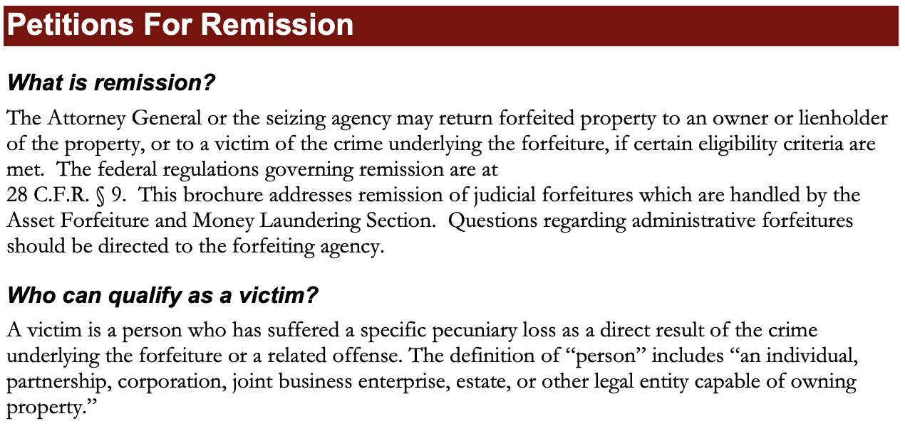
https://www.justice.gov/sites/default/files/criminal-afmls/legacy/2015/01/26/victms-faqs.pdf

Slide 10
